Slide 1
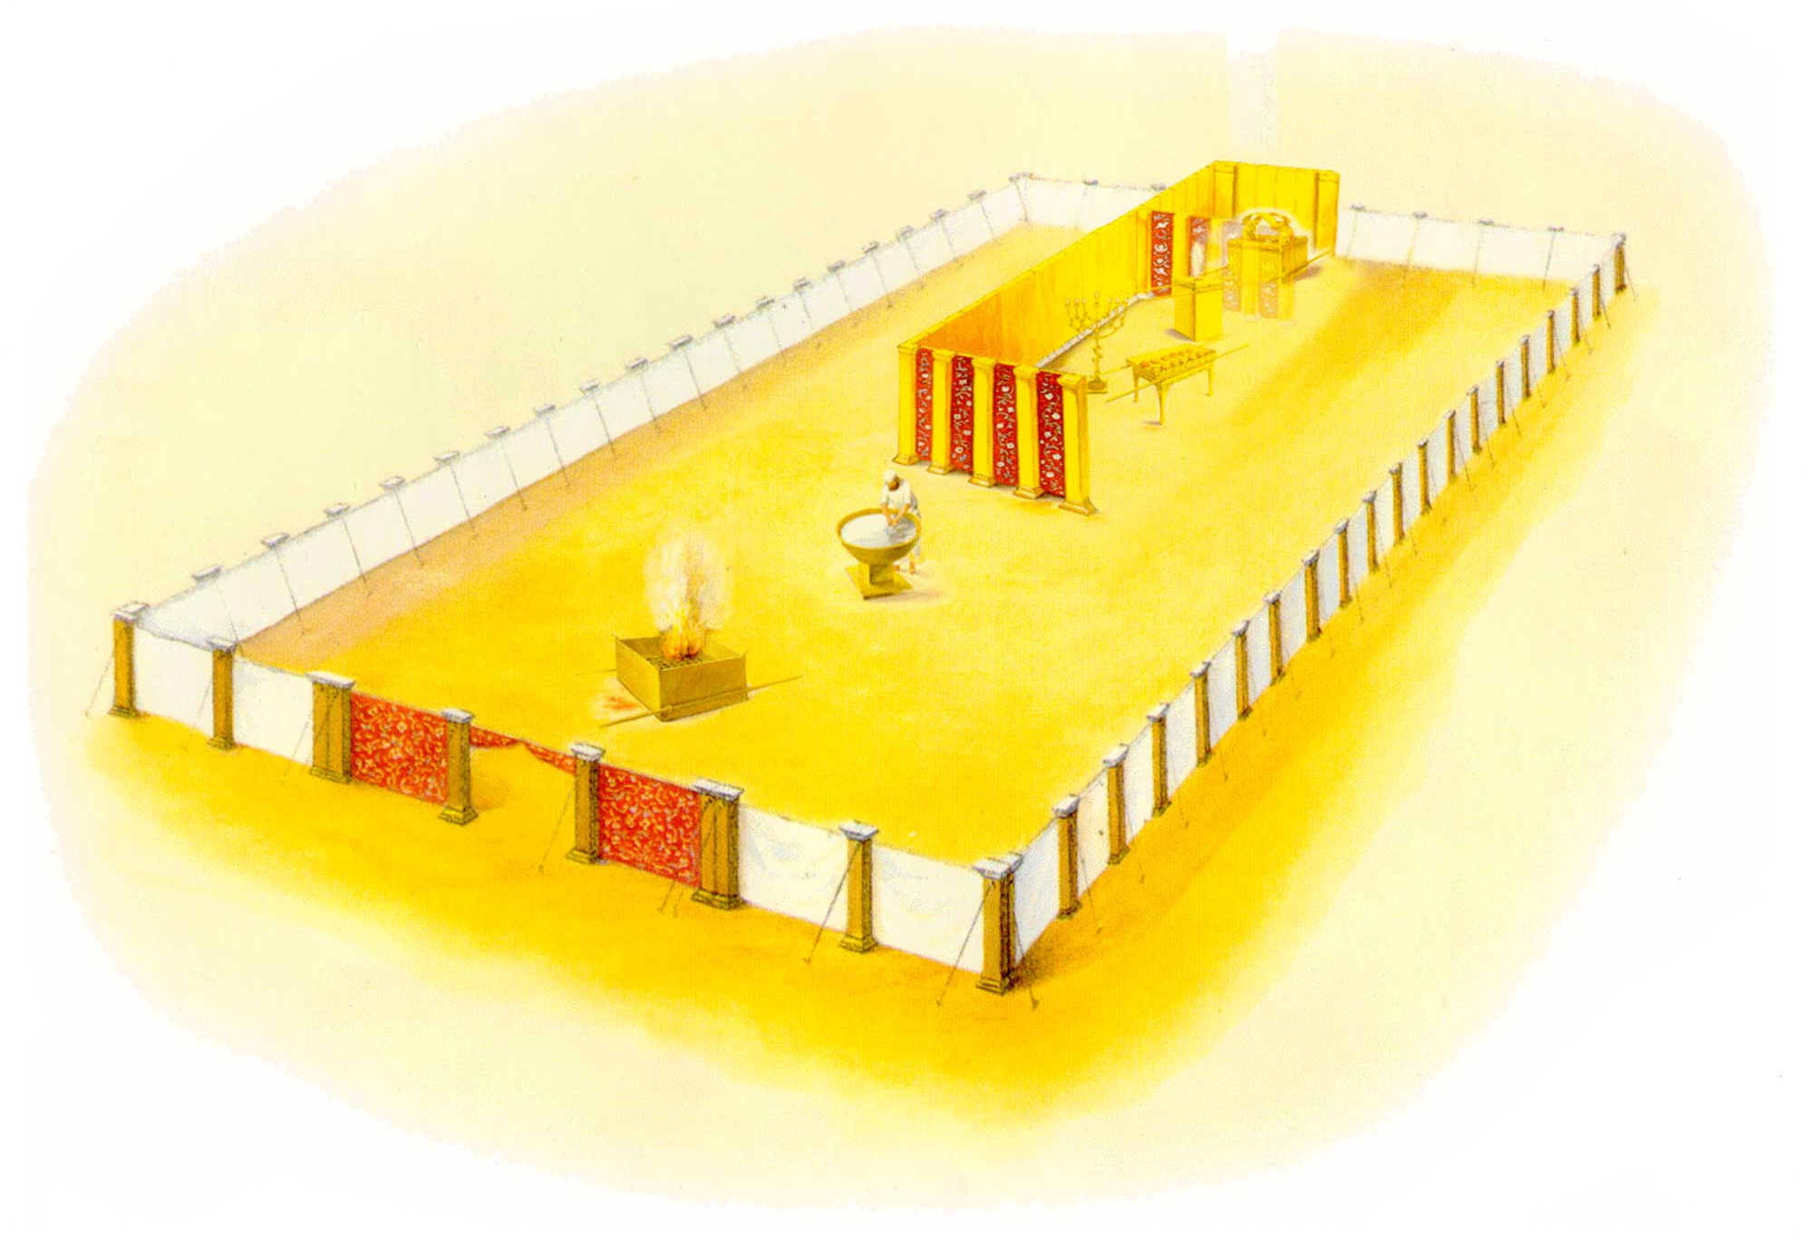
Notes:
Images used with permission for non-profit use. Templebuilders.com
http://www.templebuilders.com/tabernaclepictures/

Slide 3
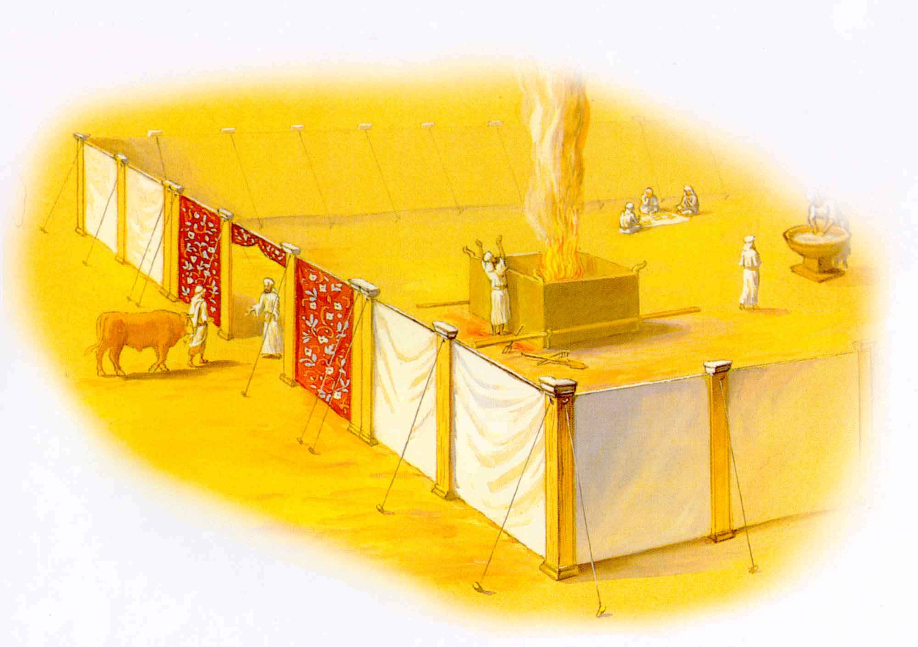

Slide 4
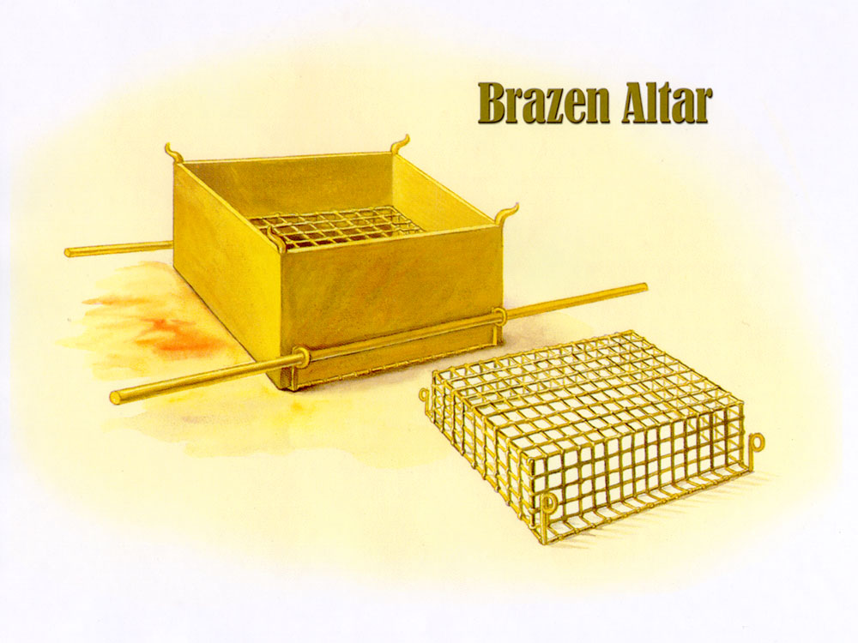

Slide 5
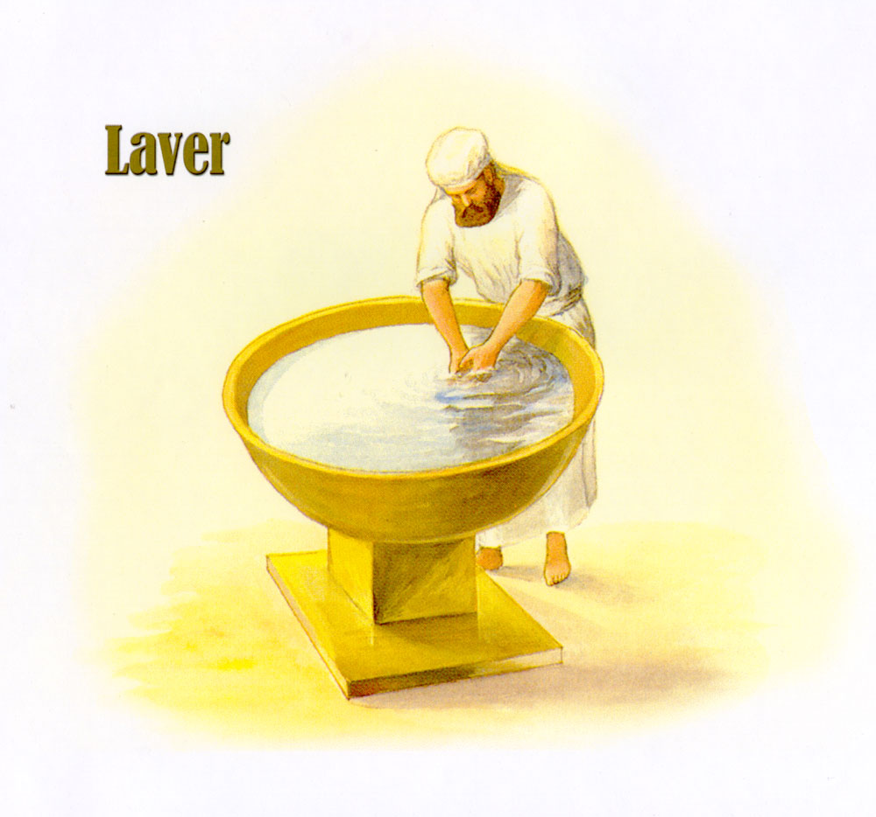

Slide 6
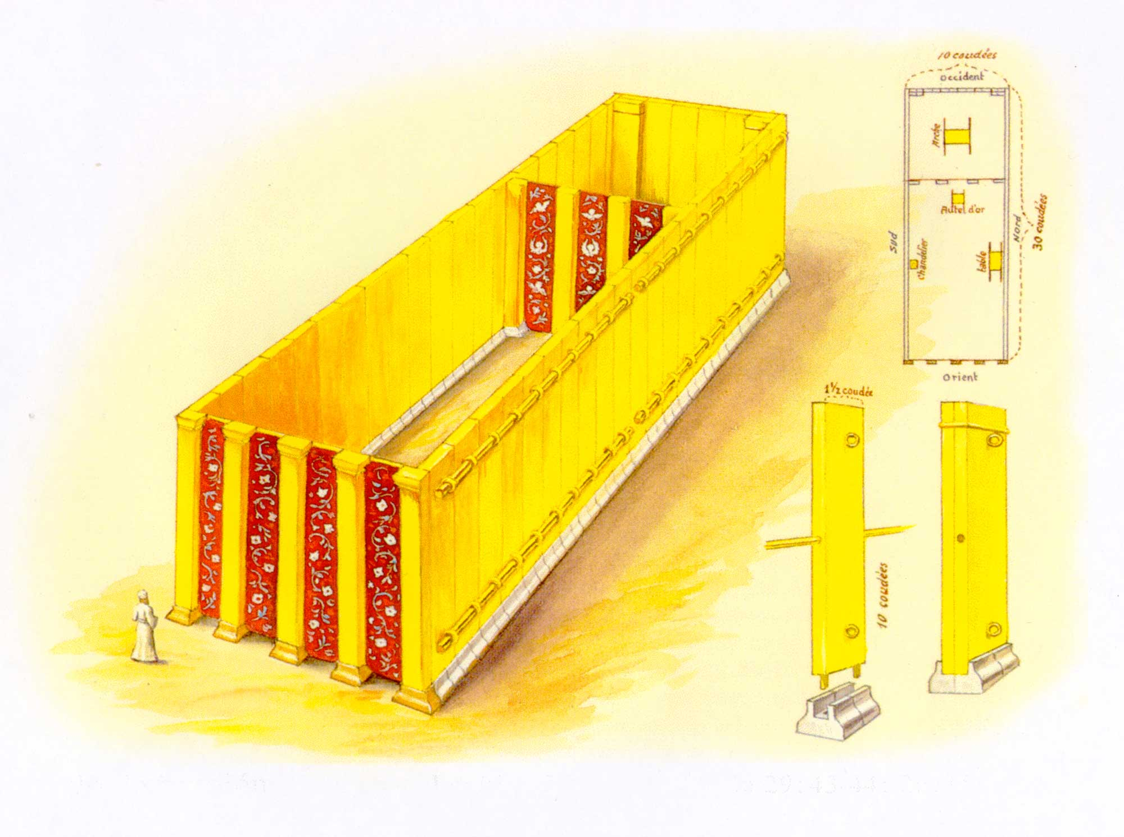
Notes:
The architecture of the Sistine Chapel is modeled after the tent of meeting.

Slide 8
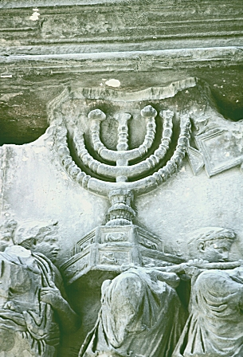
Notes:
More on Arch of Titus: http://www.bluffton.edu/~sullivanm/titus/titus.html

Slide 10
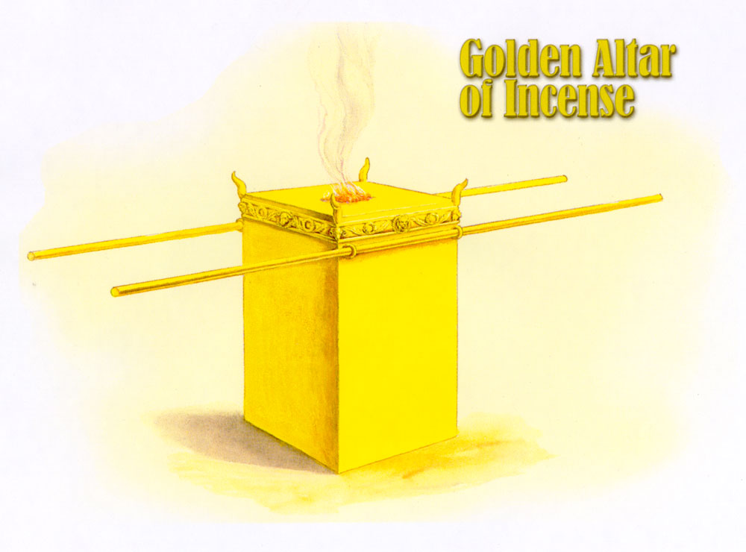

Slide 11
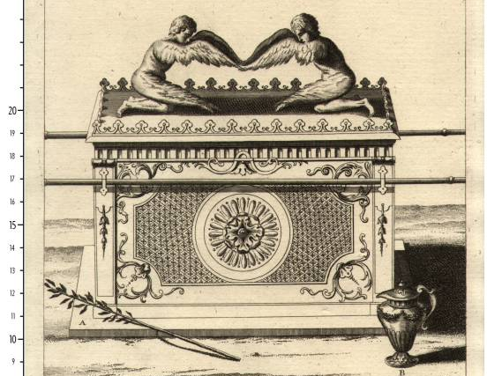
Notes:
Arc of covenant contained tables of Law and manna.
Jesus, whose flesh is stored in the Christian tabernacle, is the Word (Law) made flesh in the form of bread.

Slide 12
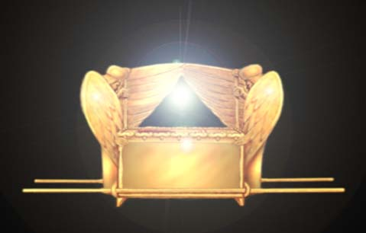

Slide 13
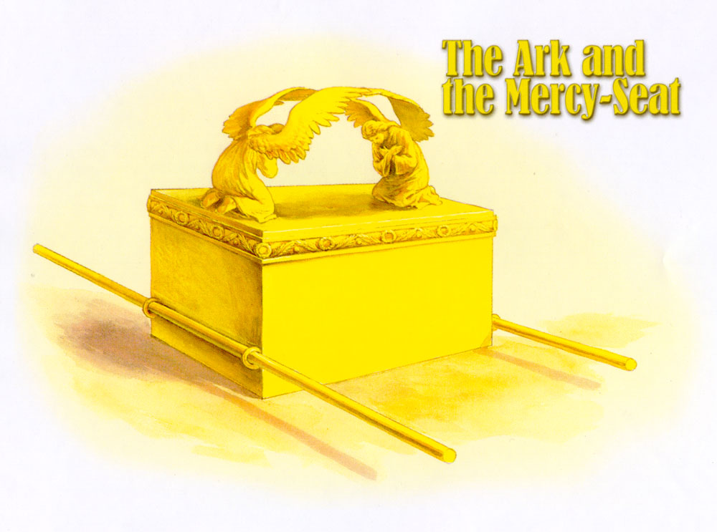

Slide 14
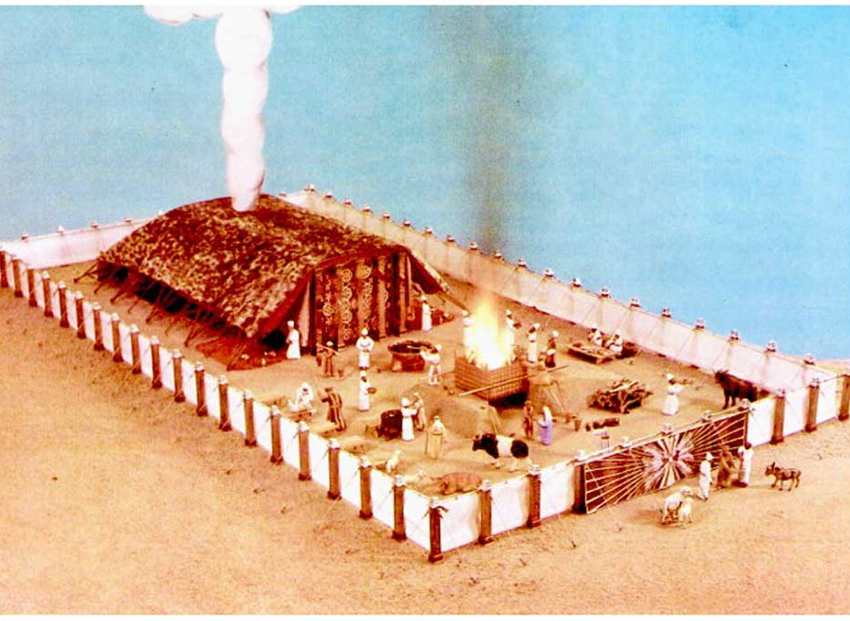

Slide 15
