Slide 1
Discovery Imaging and Reimagining Discovery
Todd R. Hanneken, Ph.D.
St. Mary’s University, San Antonio, Texas

Slide 2
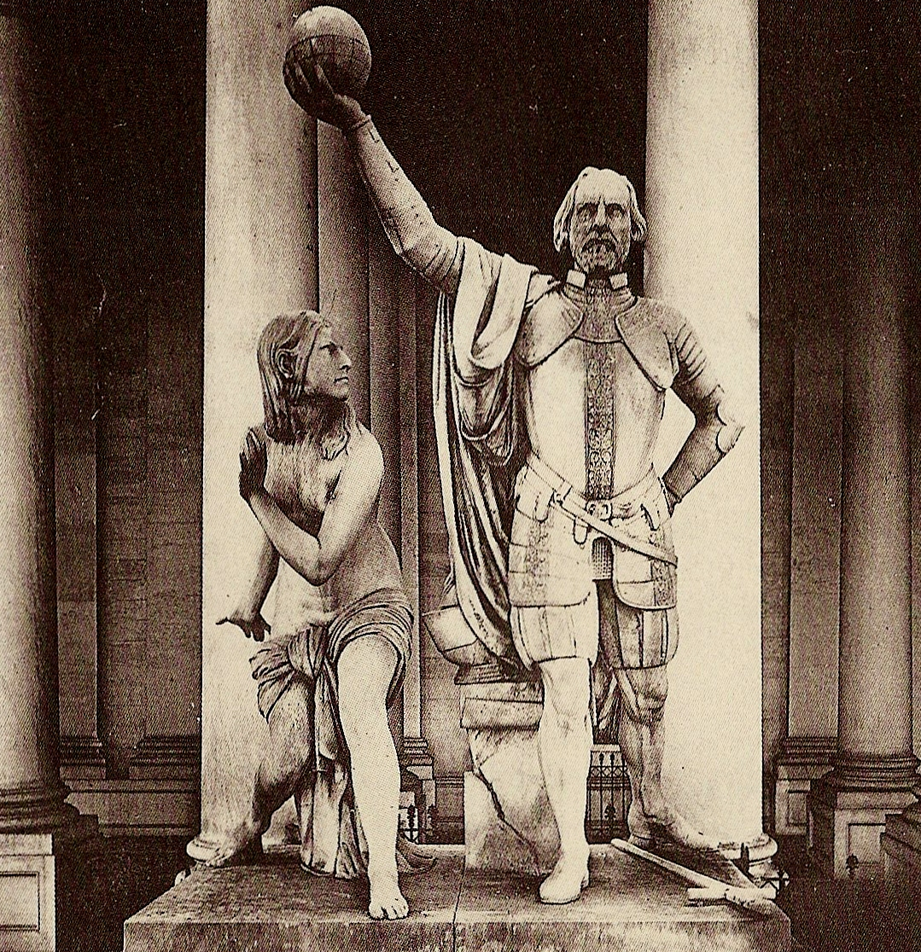

Slide 3
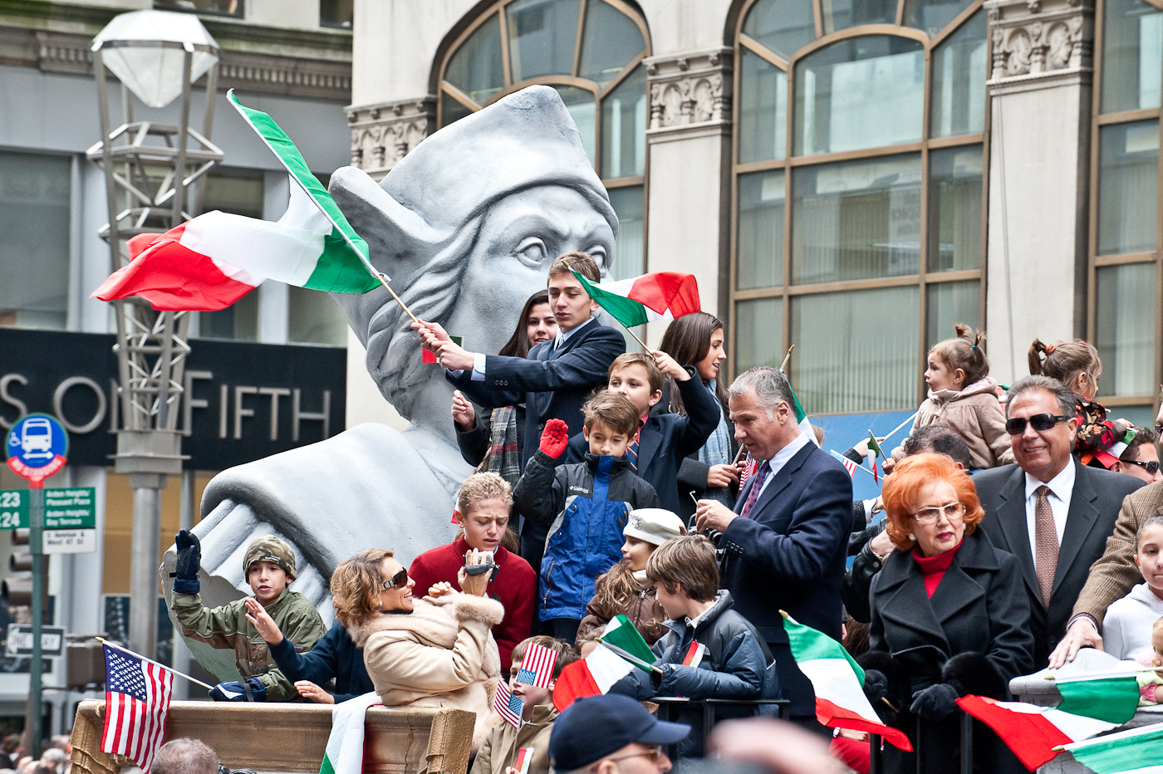

Slide 4
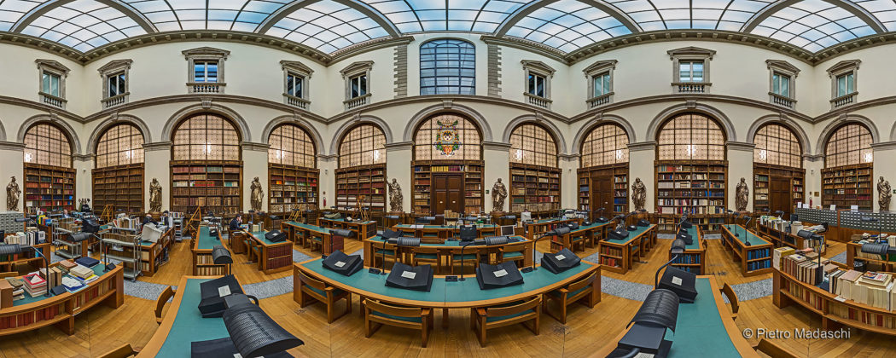

Slide 5
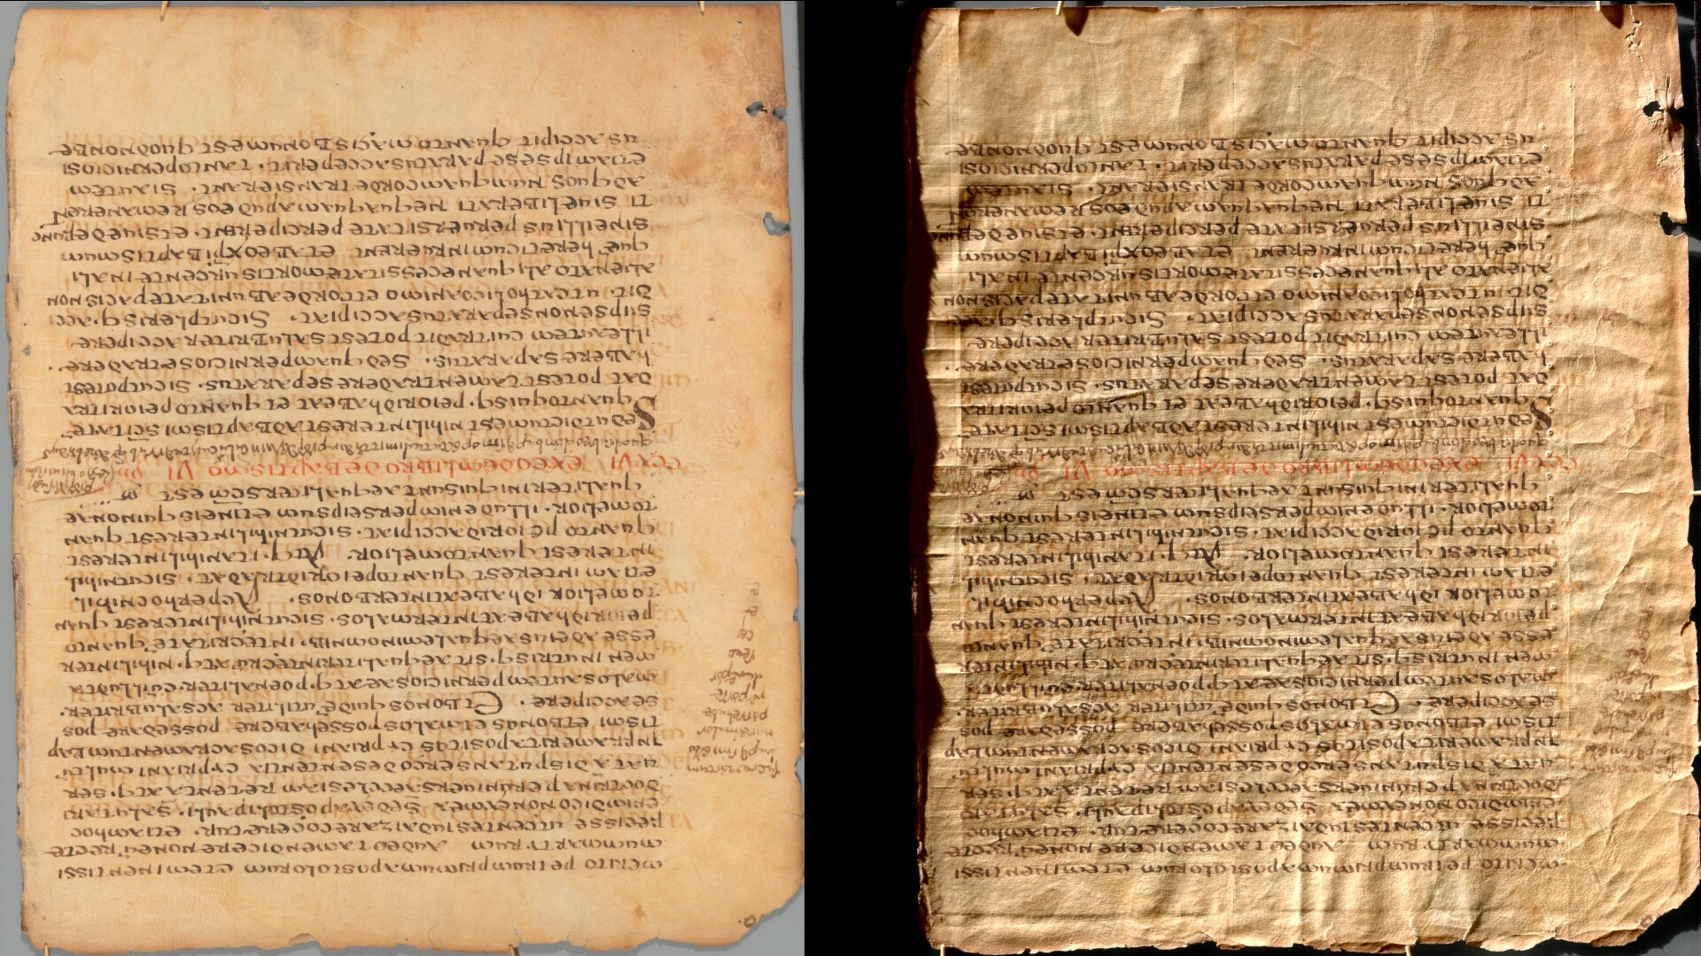

Slide 6
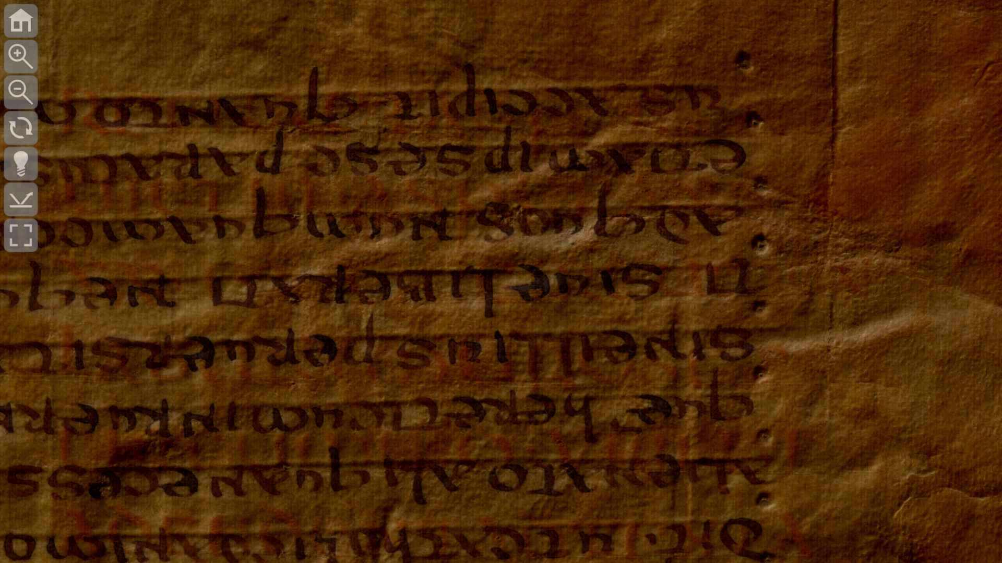
https://palimpsest.stmarytx.edu​/relight​/Ambrosiana​_C73inf​_110.html

Slide 7
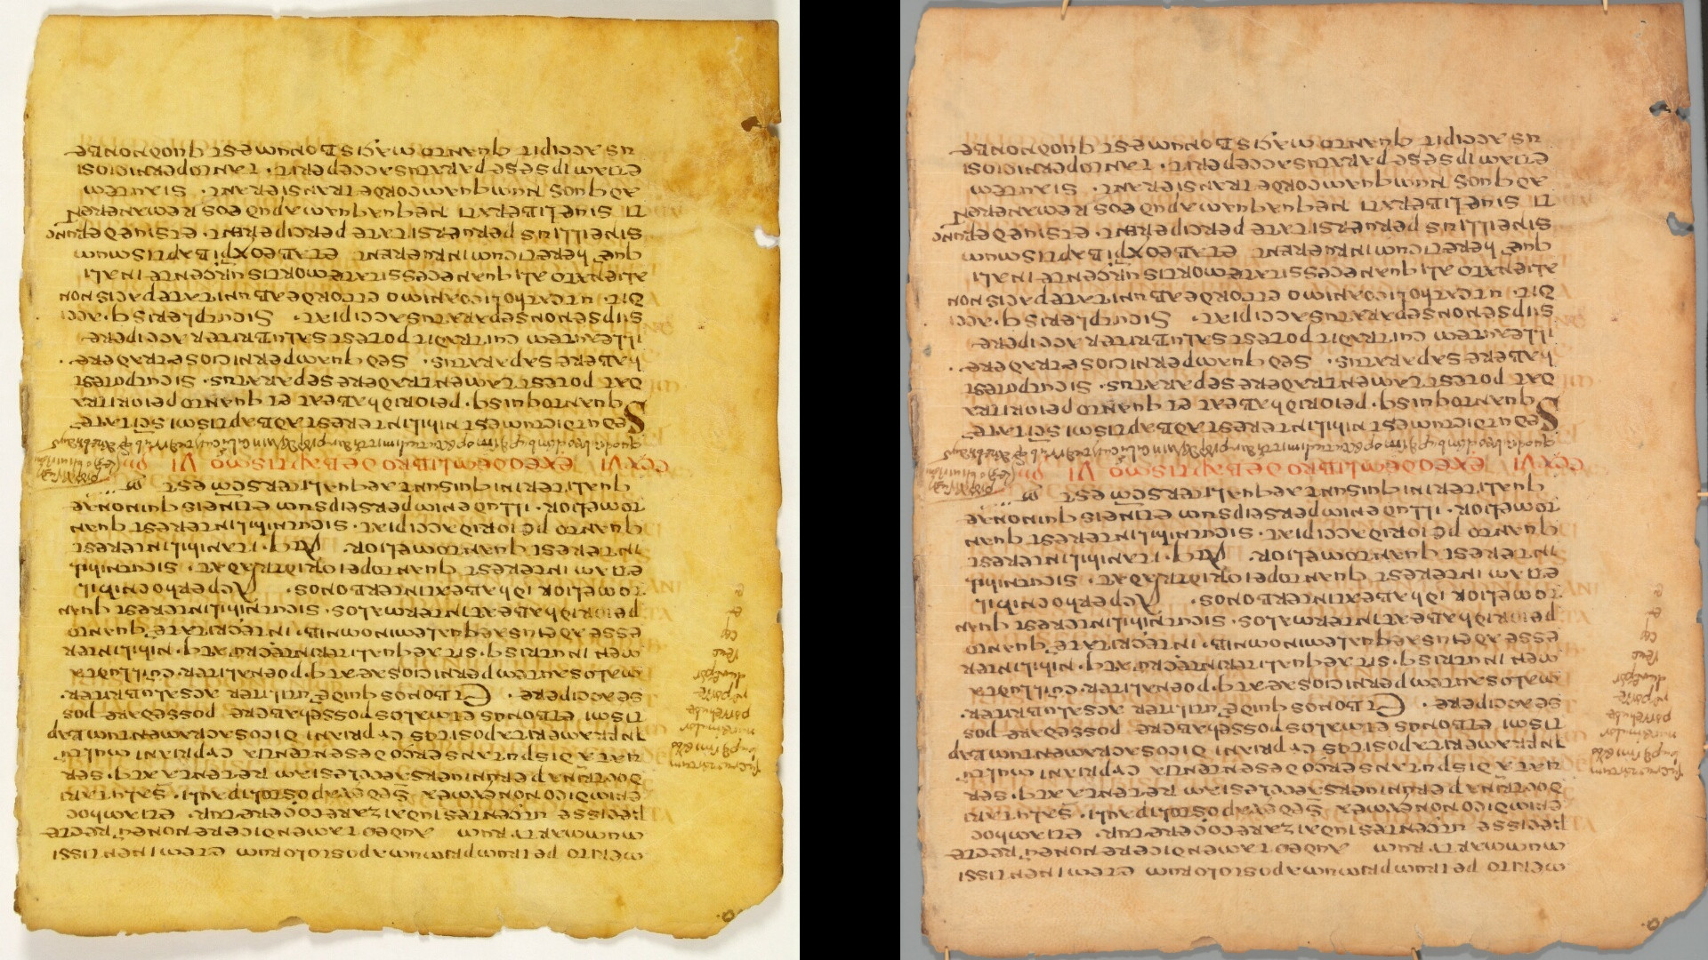

Slide 9
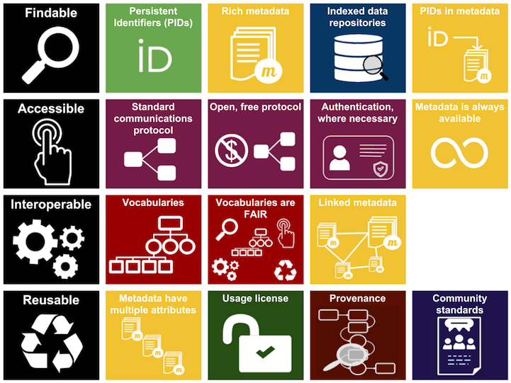

Slide 10
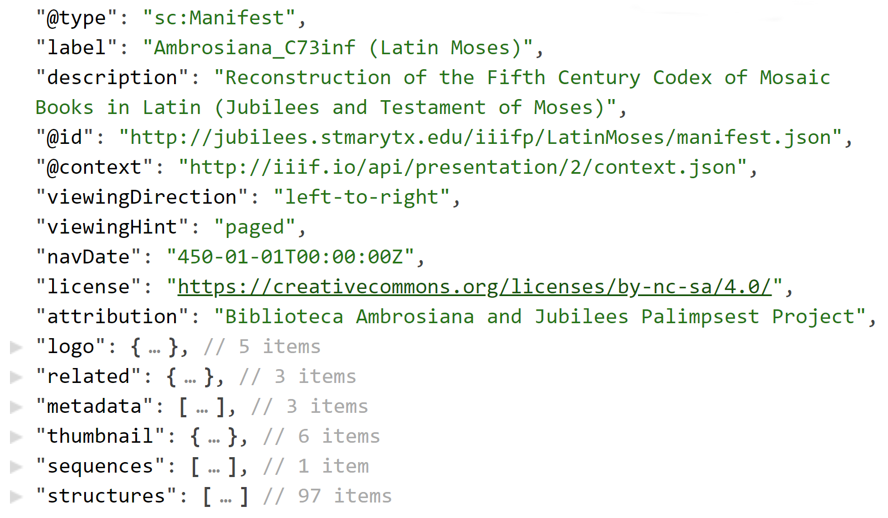
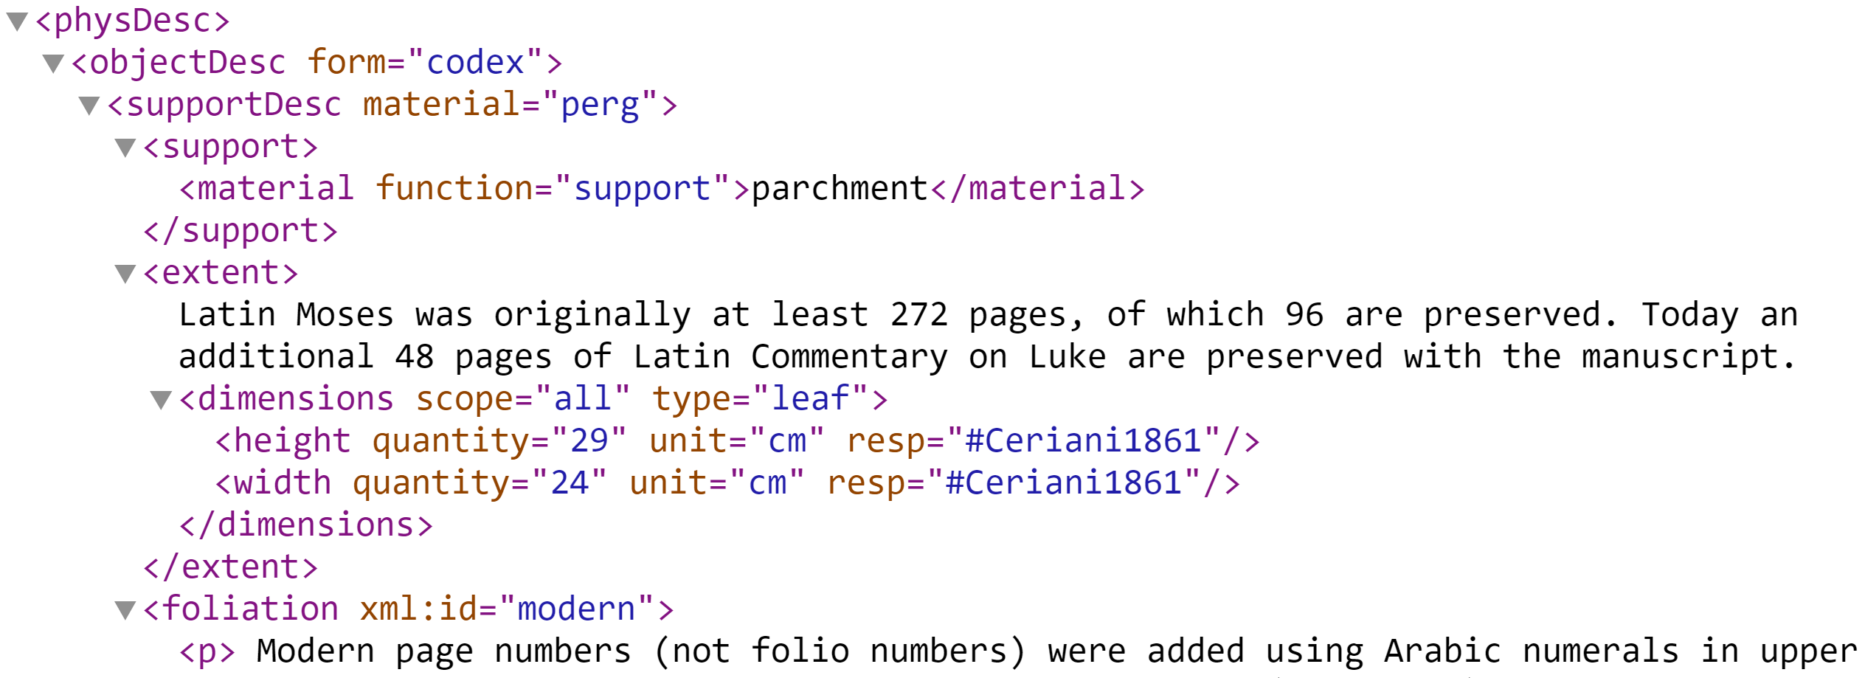

Slide 11
Discovery Imaging and Reimagining Discovery
Todd R. Hanneken, Ph.D.
St. Mary’s University, San Antonio, Texas

